Slide 1
State Machine
Designing components using a finite state machine model.

Slide 2
When State Matters
Some components behave differently depending on what state they are in.
Examples:
Alarm Clock
Calculator
Stop Watch
Point of Sale (POS) device
most parsers

Slide 3
Really Simple Example
Stopwatch behaves differently when it is RUNNING or STOPPED.
What behavior depends on state?
Easy! just look for methods containing "if (running) …"

Slide 4
Identify States
Stopwatch states: RUNNING and STOPPED
RUNNING
STOPPED

Slide 5
Events
What causes a stopwatch to change state?
Why not stay in the same state forever?
RUNNING
STOPPED

Slide 6
Action
The stopwatch performs some action in response to an event.
RUNNING
entry/ start timer
STOPPED
entry/ stop timer

Slide 7
Activities
An activity is something that lasts for some time.
An action is (nearly) instantaneous.
In the UI for StopWatch, "update display" is an activity.

Slide 8
Programming a State Machine
Design the state machine first – step by step.
1. Identify the states
2. Identify events: external and internally generated
3. Identify actions or activities the state machine performs in response to events or change in state.
4. Draw a diagram.
Finally,
5. Code state-dependent behavior using state machine.

Slide 9
What behavior depends on state?
We use boolean running to keep track of state.
class StopWatch {
private boolean running;
public void start( ) {
if (running) return;
startTime = System.nanoTime();
running = true; // change state
}

Slide 10
What behavior depends on state?
public double getElapsed() {
if (running)
return (System.nanoTime()-startTime)
* NANOSECONDS;
else
return (stopTime-startTime)
* NANOSECONDS;
}
public void stop() {
if (! running ) return;
stopTime = System.nanoTime();
running = false;
}

Slide 11
The State Variable
We used a boolean (running) to record the state.
This only works when there are just 2 states.
For more states we need another type of state variable.
Consider: a StopWatch with Start, Stop, and Hold buttons.
Each button is the source of event.
Now there are 3 states.

Slide 12
2 ways to represent state
// use "int" or "char"
class StopWatch {
int state;
final int STOPPED = 0;
final int RUNNING = 1;
final int HOLDING = 2;
public void start( ) {
if (state == RUNNING)
// use an enum
public enum State {
STOPPED,
RUNNING,
HOLDING;
}
class StopWatch {
State state;
public void start() {
if (state == RUNNING)

Slide 13
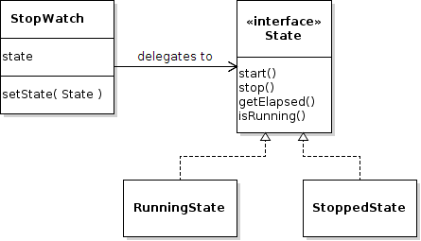
The O-O Approach
Use Objects to encapsulate state and the behavior that depends on state.
The context delegates behavior to state objects.

Slide 14
Delegating Behavior
Delegate means "let someone else do it".
Stopwatch delegates behavior to the state.
public class StopWatch {
private State state;
public void start( ) { state.start(); }
public void stop() { state.stop(); }
public double getElapsed() {
return state.getElapsed();
}

Slide 15
State Objects and Changing State
The context (StopWatch) needs a setState method as a way of changing the state.
The states need a reference to the context.
// Create the states with a reference to
// the stopwatch (the context)
final State RUNNING = new RunningState(this);
final State STOPPED = new StoppedState(this);
// provide a method for changing the state
public void setState(State newstate) {
this.state = newstate;
}

Slide 16
Example of Changing State
If the stopwatch is running and the Stop button is pressed, then change to stopped state...
class RunningState implements State {
private StopWatch context;
public void stop() {
context.stopTime = System.nanoTime();
context.setState( context.STOPPED );
}
public void start() {
// already running so do nothing
}

Slide 17
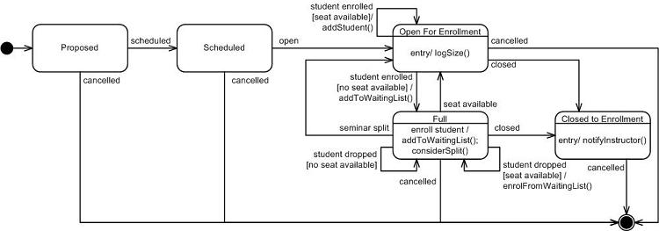
UML State Machine Diagram

Slide 18
UML State Machine Diagram
Read UML Distilled, chapter 10.
Also good: UML for Java Programmers, chapter 10.

Slide 19
Exercise: Skytrain Ticket Machine
1. What are the states.
2. What are the events.
3. What actions/activities does ticket machine perform?
4. Draw a UML State Machine Diagram.

Slide 20
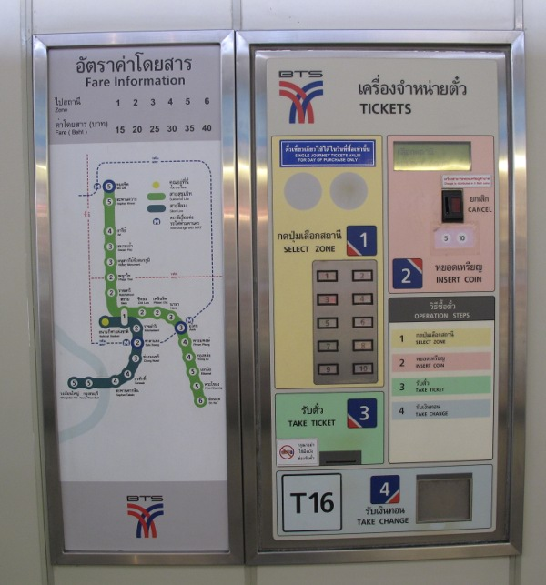

Slide 21
Exercise: Syllable Counter
Count the syllables in a word.
As a heuristic, we will count vowel sequences.
Example:
object = (o)bj(e)ct = 2 vowel sequences
beauty = b(eau)t(y) = 2 vowel sequences
Special cases:
l(a)y(ou)t = treat "y" as consonant after other vowel
l(a)the = don't count final "e" if it is a single vowel
m(o)v(ie) = 2 vowel seq. "final e" rule doesn't apply here.
th(e) = exception. count final "e" if it is only vowel
anti-oxident = (a)nt(i)-(o)x(i)d(e)nt "-" is non-vowel

Slide 22
Example Words
How many vowel sequences in these words:
remarkable
selfie
county
coincidentally
she
mate
isn't

Slide 23
Exercise: Calculator
A calculator that behaves like Windows calc.
Use: http://www.online-calculator.com
1. What are the states.
2. What are the events.
3. What actions/activities does ticket machine perform?
4. Draw a UML State Machine Diagram.
(not so easy)

Slide 24
PA5: Cheap Digital Clock
cheap digital alarm clock.
Use states!

